Slide 1
Module II Supervised and Unsupervised Learning
Tree-Based Methods

Slide 2
Tree-Based Methods
Tree-Based Methods are supervised learning algorithms that perform classification by recursively splitting the dataset into subsets based on feature values.
The model is represented in the form of a decision tree, where internal nodes represent decisions, branches represent outcomes, and leaf nodes represent class labels.
These methods excel at capturing non-linear relationships and interactions between features without requiring explicit feature engineering

Slide 3
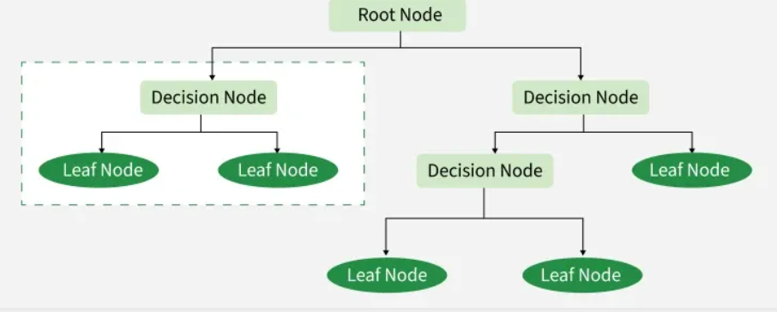
Decision Tree
Decision Tree is a flowchart-like structure used for classification:
Root node → represents the entire dataset
Internal nodes → represent feature tests
Branches → outcomes of tests
Leaf nodes → predicted class labels

Slide 4
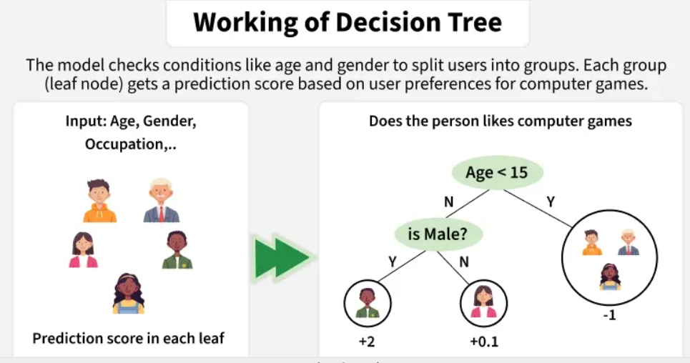
Working Principle
Select the best feature to split the data
Split the dataset into subsets
Repeat recursively for each subset
Stop when a stopping condition is met
Assign class labels at leaf nodes

Slide 5
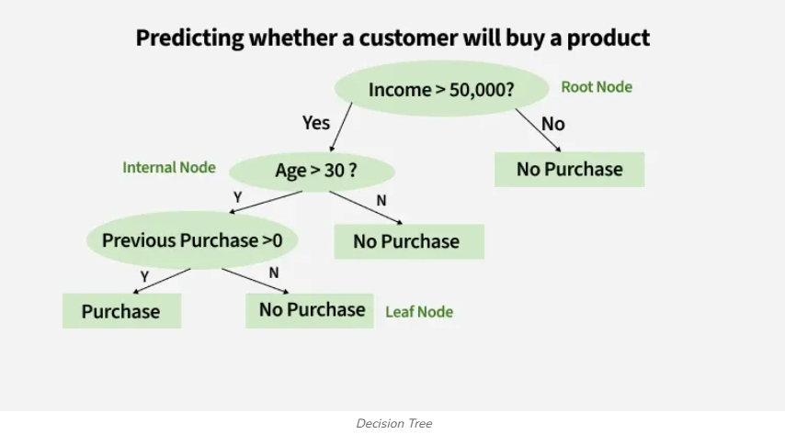
Example

Slide 6
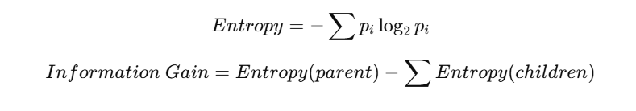
Attribute Selection Measures
To choose the best split, decision trees use impurity measures:
Information Gain (ID3)
Based on Entropy
Measures impurity or randomness:
Information Gain
Reduction in entropy after a split

Slide 7
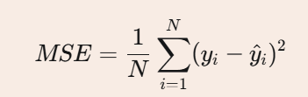

Mean Squared Error
Measures average squared difference between predicted and actual values.
Gini Index (CART)
Measures the probability of incorrect classification:
Gain Ratio (C4.5)
Normalized Information Gain
Reduces bias toward multi-valued attributes

Slide 8
Popular Tree-Based Algorithms
ID3 (Iterative Dichotomiser 3)
Uses Information Gain
Works with categorical data
No pruning
It builds trees by selecting attributes that best split the data based on information gain
Mathematical Foundation
Entropy
Information Gain

Slide 9
How ID3 Works
Calculate Entropy
Compute entropy for the entire dataset to measure initial impurity
Compute Information Gain
Calculate information gain for each attribute to find best split
Select Best Attribute
Choose attribute with highest information gain as decision node
Split Dataset
Partition data based on selected attribute values
Recurse
Repeat process for each subset until pure nodes or stopping criteria met

Slide 10
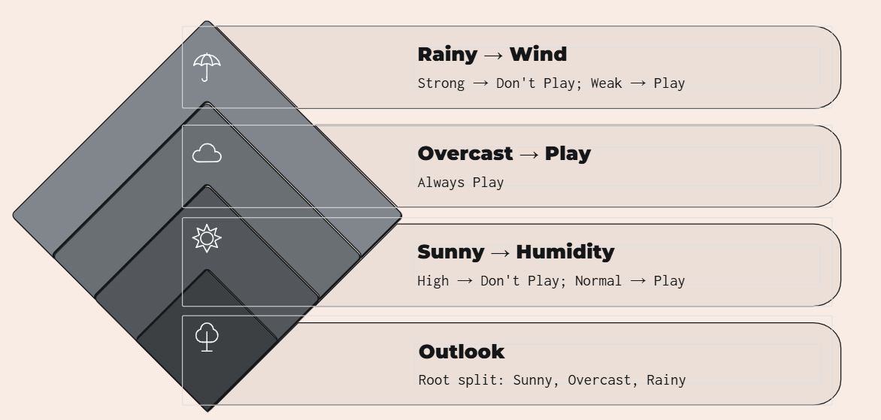
ID3 Decision Tree Structure

Slide 11
Limitations
Prone to overfitting
Only handles categorical data
Biased toward multi-valued attributes
Cannot handle missing values
Greedy algorithm (local optimum)

Slide 12
Real-Time Machine Learning Uses
Medical Diagnosis
Classifying diseases based on patient symptoms and test results
Fraud Detection
Identifying fraudulent transactions in real-time banking systems
Customer Segmentation
Categorizing customers for targeted marketing campaigns
Email Filtering
Classifying emails as spam or legitimate messages

Slide 13
CART (Classification and Regression Trees)
Uses Gini Index
Supports classification and regression
Produces binary trees
Decision Trees
CART builds binary trees by recursively splitting data based on feature values to make predictions.
Dual Purpose
Handles both classification (categorical outcomes) and regression (continuous values) problems.
Interpretable
Creates transparent, easy-to-understand models that mirror human decision-making processes.

Slide 14
How CART Works
Select Best Split
Algorithm evaluates all features and thresholds to find the split that maximizes information gain or minimizes impurity.
Partition Data
Data is divided into two subsets based on the chosen feature and threshold value.
Recursive Splitting
Process repeats on each subset, creating child nodes until stopping criteria are met.
Pruning
Tree is trimmed back to prevent overfitting and improve generalization to new data.

Slide 15
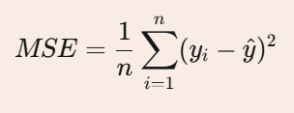

Splitting Criteria Equations
Mean Squared Error (Regression)
For regression tasks, CART minimizes MSE where represents actual values and is the predicted mean.
Entropy (Classification)
Entropy measures disorder in the dataset, with being the proportion of class samples

Slide 16
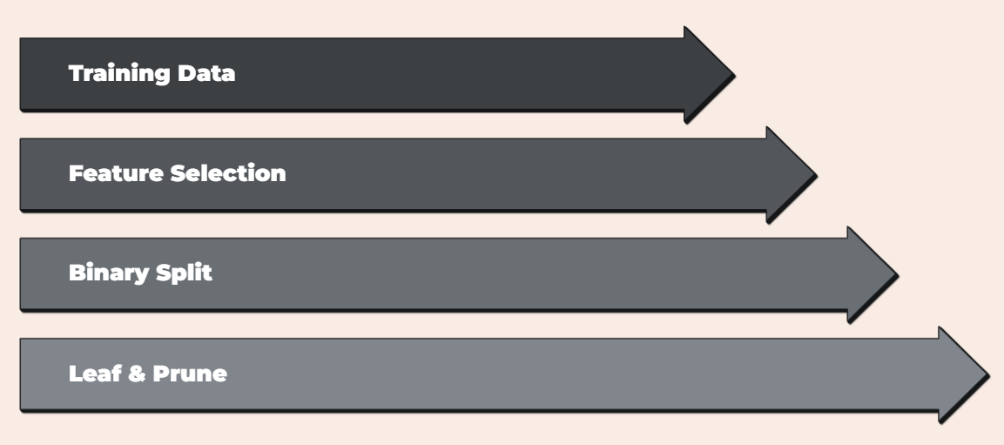
CART Algorithm Block Diagram

Slide 17
Key Advantages of CART
Interpretability
Minimal Preprocessing
Feature Importance
Fast Predictions

Slide 18
C4.5
Extension of ID3
Uses Gain Ratio
Handles missing values
Supports pruning

Slide 19
Tree-Based Classification Example
Problem: Classify students as Pass or Fail based on:
Attendance
Internal marks
The tree splits data based on the most informative attribute at each level.

Slide 20
Overfitting Control in Decision Trees
Pruning (pre-pruning / post-pruning)
Limiting tree depth
Minimum samples per node

Slide 21
Applications
Medical diagnosis
Credit approval systems
Customer churn prediction
Fraud detection

